Slide 1
Design Portfolio
Kourtney Collins
Horticulture 203

Slide 2
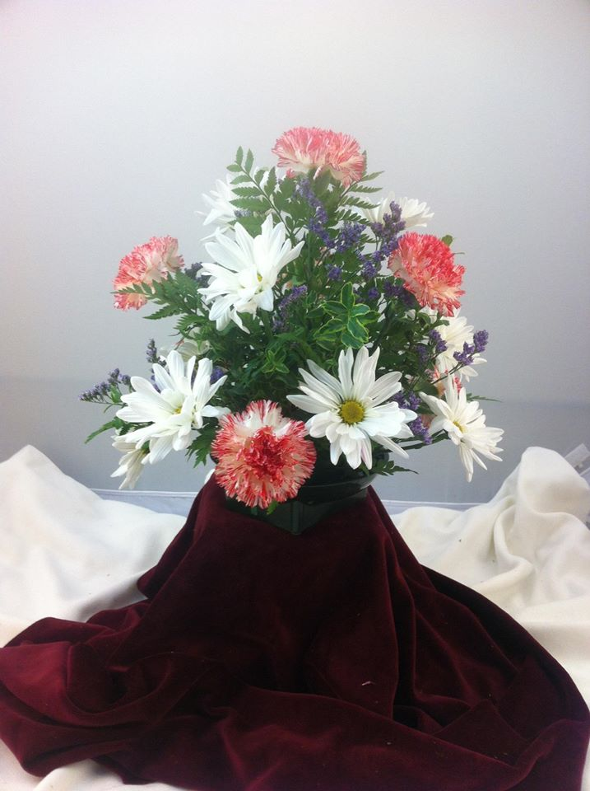
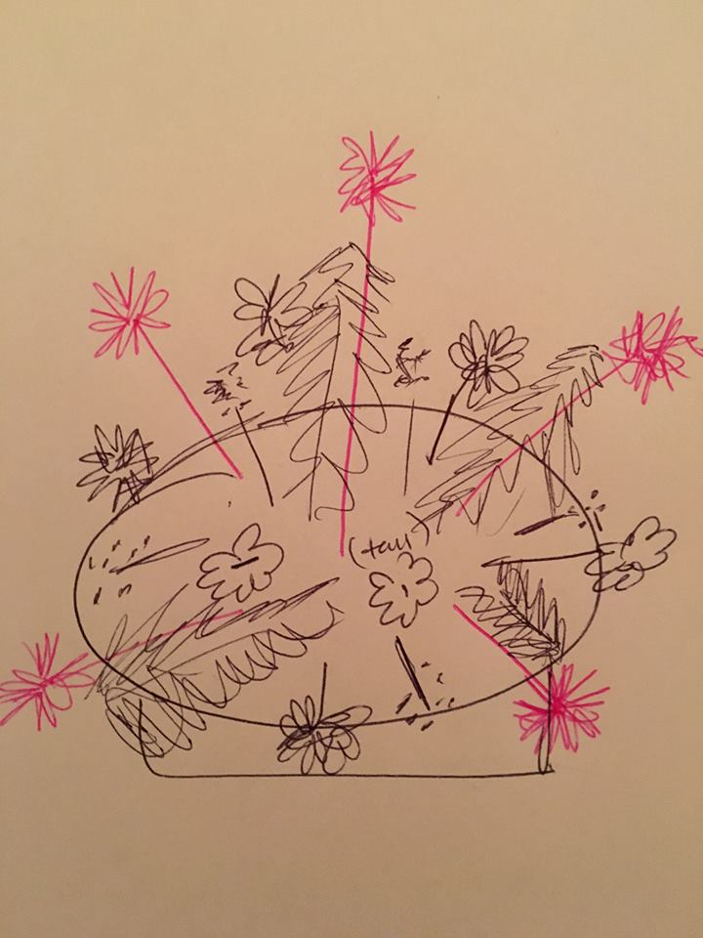
Round Centerpiece-Carnations, daisys, leatherleaf, vase
Form-The overall form is a round/dome-like shape that is evenly spaced out from each side. The greenery helps give the over shape by creating the levels to the “dome”.
Proportion-the placement of each carnation and easy daisy complements each other and fills in the space between each other. The filler supports the shape and the mass breaks apart the green while also keeping each side/flower the same level for each point in the dome.

Slide 3
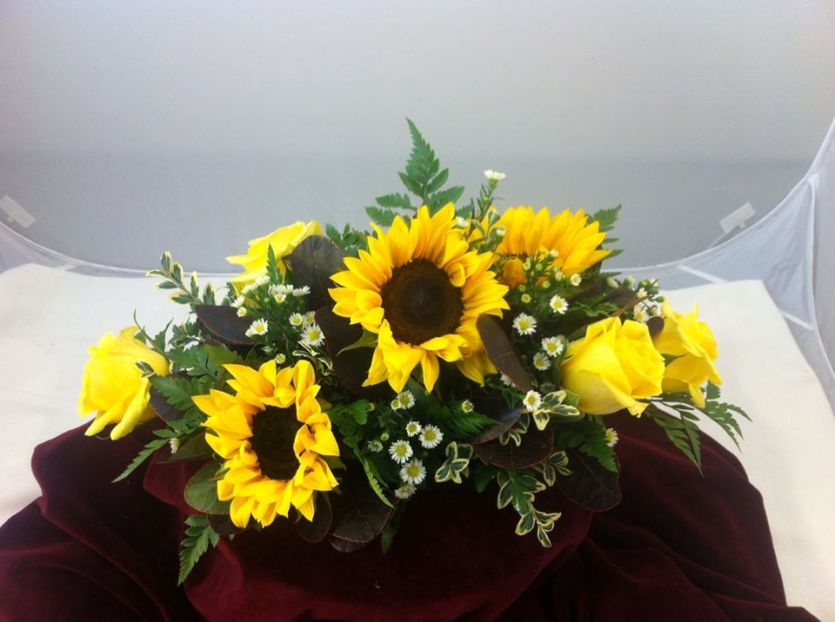
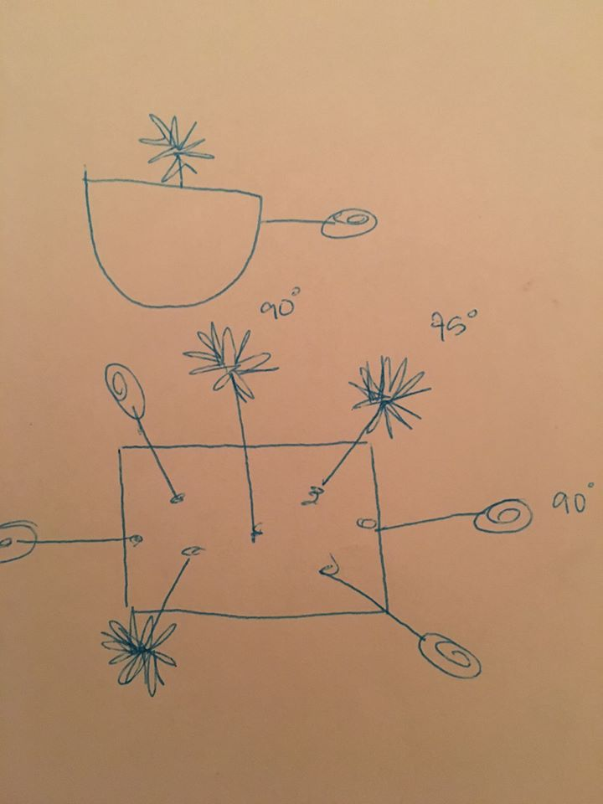
Horizontal-Rose, Sunflower, Aster, vase
Size- The size was important to work with because it was a flatter and wider piece that had to complement where each flower was placed without being to long or short.
Balance- The sunflowers and roses are both mass and they balance each other out in that the sunflowers are more centered and focused, the smaller roses draw the eye in also.

Slide 4
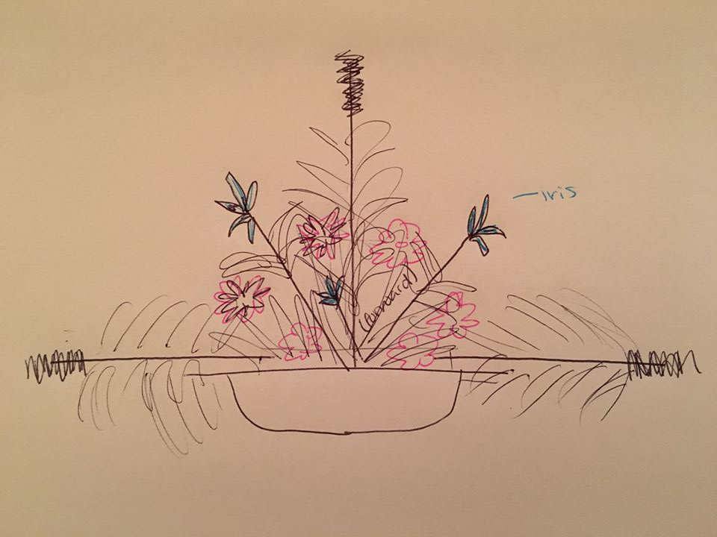
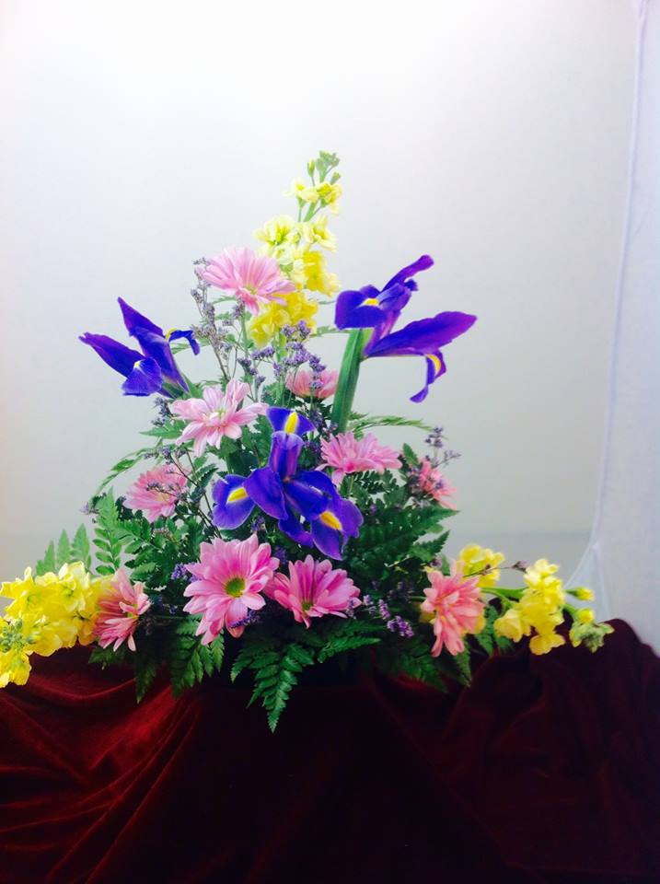
Symmetrical Triangle-Iris, leatherleaf, daisy mums, vase
Line-Each long stem represented a line extending from the center creating a triangle and another within. The last points on each triangle shape gave the overall shape to the design.
Contrast-The two triangles are made with two very different flowers that also contrast in color so they become very distinct.

Slide 5
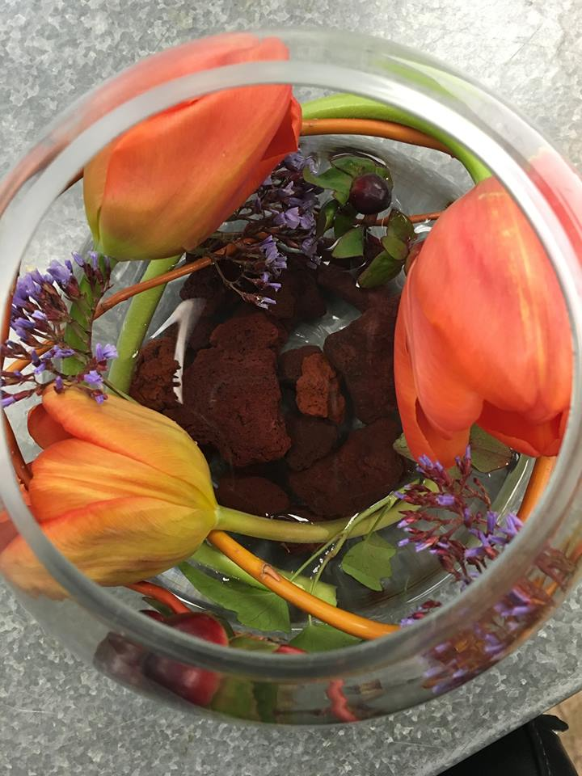
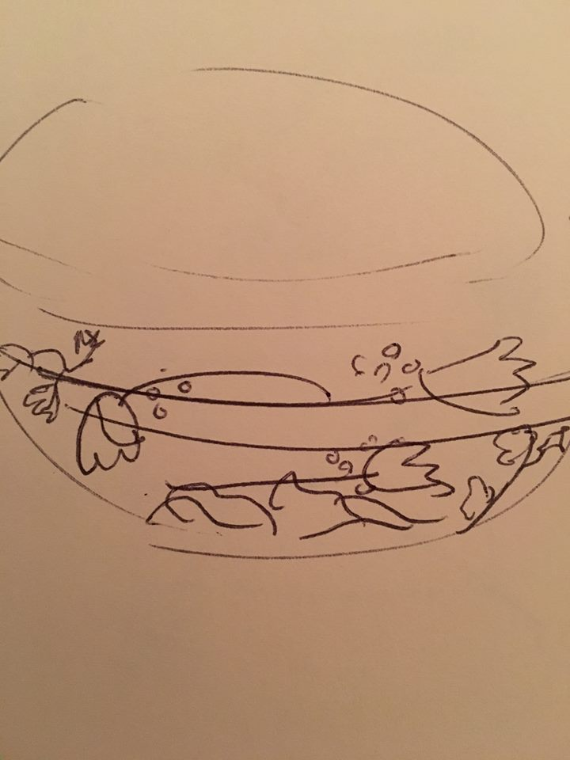
Swirl Vase- Curly Willow, Hypericum, English ivy, Tulip, rocks, vase
Space- each tulip was evenly spaced throughout the vase and gave the inside of the vase empty space.
Armature-The willow in the vase supports the flowers and keeps all the stems upright and the rocks in the bottom hold down the bigger stems and looks appealing.

Slide 6
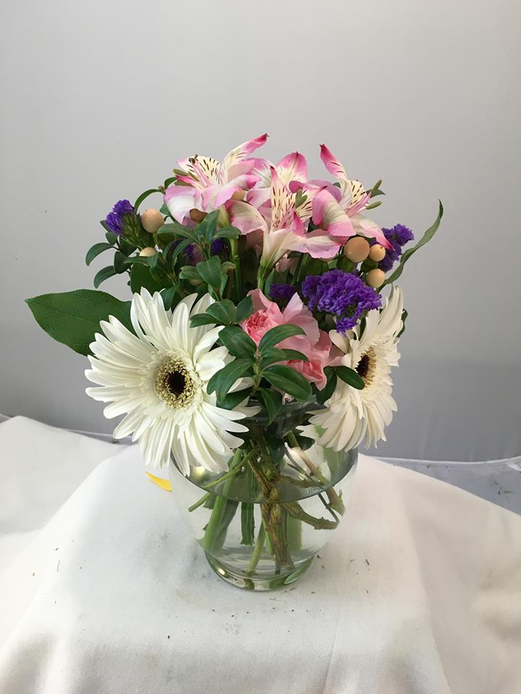
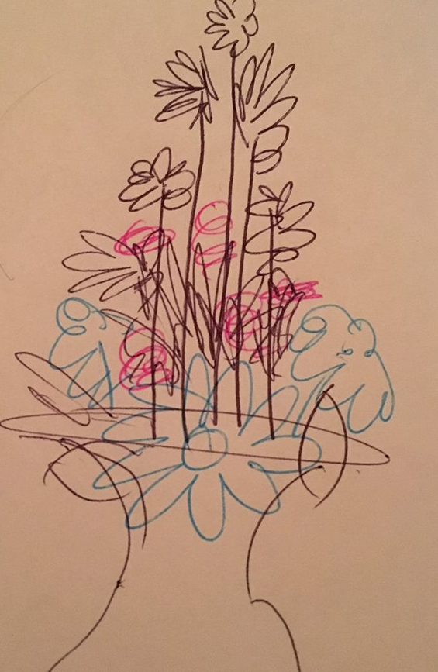
Vase Levels-Gerbera Daisy, Aster, vase, spray carnations
Balance- the balance between the size of the vase to the size of the flower on top balance each other. Also it is more full on the bottom compared to the top, but it is balanced because the top is more full and not to thin.
Form-The form was a towering shape that started at the top being the tallest and in the center. The mass was close to the vase and balanced each side.

