Slide 1
Winery and Vineyard
Summer Internship 2016
Kourtney Collins

Slide 2
Why here? Why a winery?
Dripping Springs is the current wedding capitol of Texas. With my interests in both horticulture and events a winery seemed like a good fit for me to see how both of those interests complement each other. I found Maureen the October before I started the summer and met with her and her husband, an owner, who both play a large role at Hawk’s Shadow.
Events, people, science, plants, horticulture practices, family environment, wine….

Slide 3
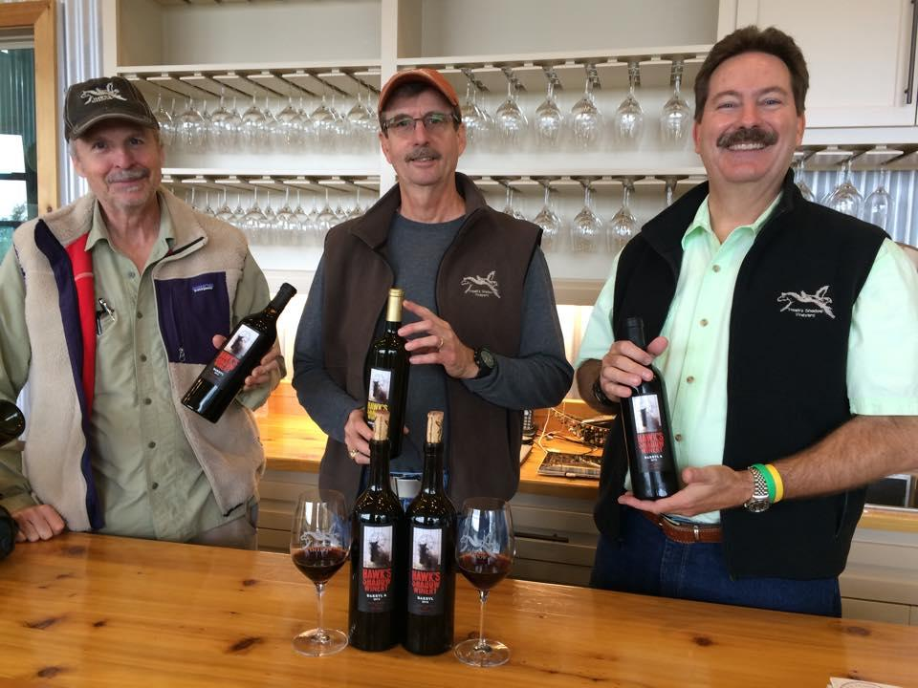
History
HSW is a small family-owned winery that specializes in crafting fine Texas wine using a combination of estate varietals and warm-climate grapes carefully chosen from Texas growers.
Owners: Tom Reed, Doug Reed, & Chip Conklin

Slide 4
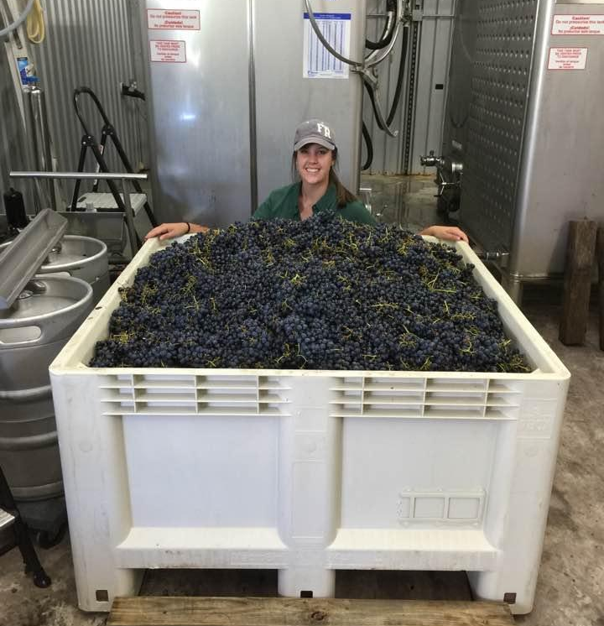
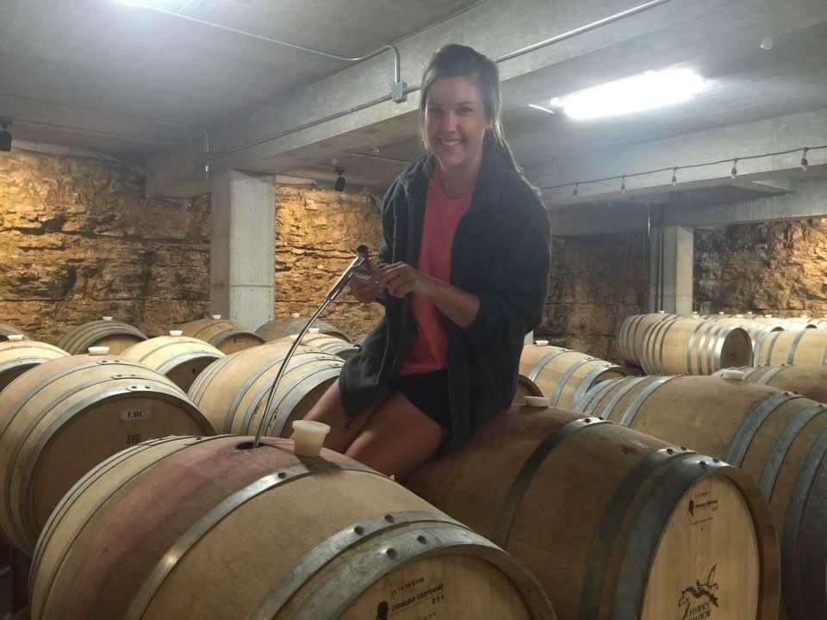
This was an unpaid internship with no benefits
I worked about 30 hours a week and not on a set schedule.
Homework was assigned to read up on diseases that affected the estate vineyard and surrounding growers. Also to understand the root grafting process from where and how the vines get started.

Slide 5
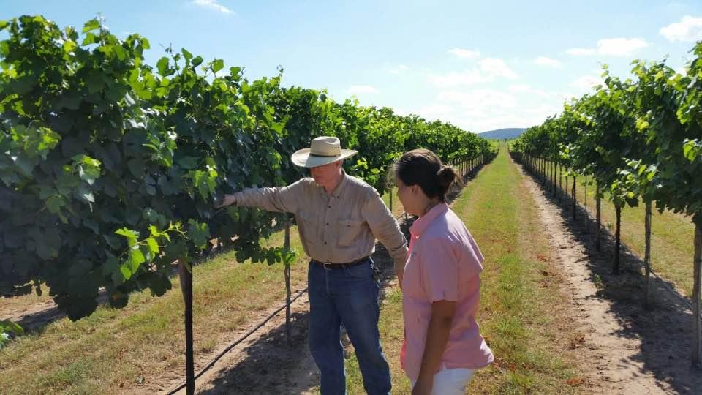

Slide 6
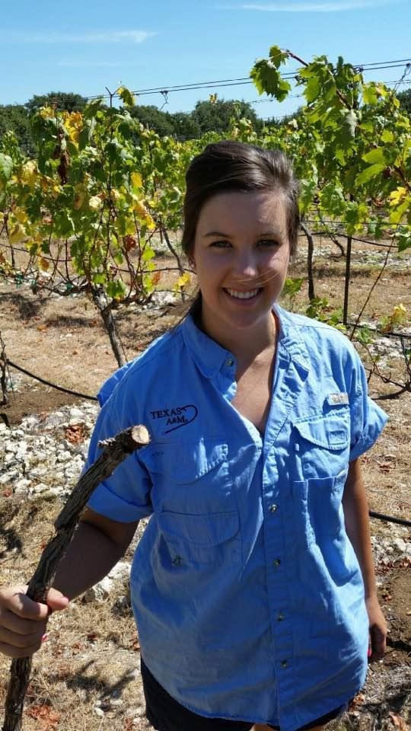
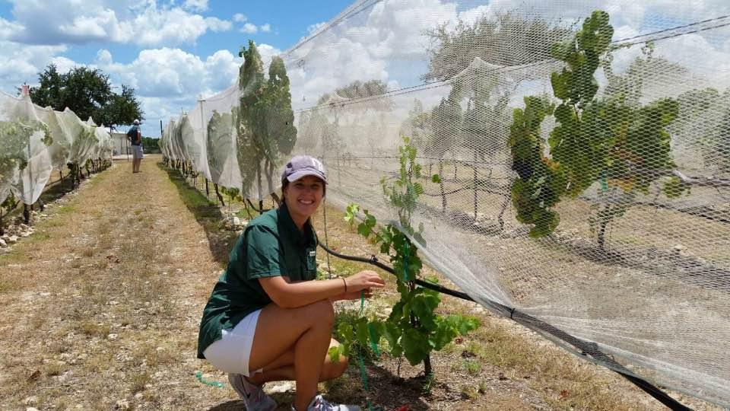
Viticulture: the science, production, and study of wine.
Vine nutrition and water management
  Hydrogen Peroxide, drip irrigation, rainwater collection
Vineyard Practices
  Canopy, training, pruning, traps
Wine Evaluation and Grape analysis
  pH levels, Sugar levels (brix), seed texture, grape ripeness
Pest and disease control
  Root rot

Slide 7
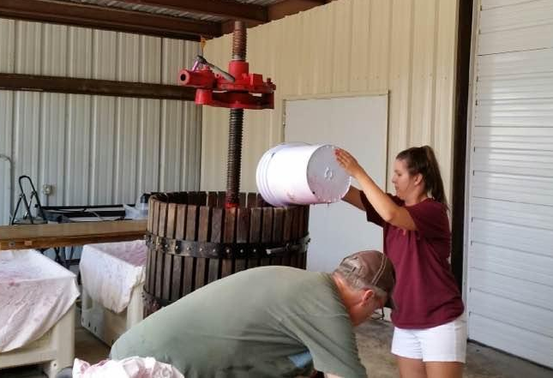
Wine Production
Wine chemistry
  SO2 adds, microbiology, environmental factors influences
Harvest, Fermentation, and Pressing
  Barrel press, “adds”, hand sorting post-harvest
Bottling and labeling

Slide 8
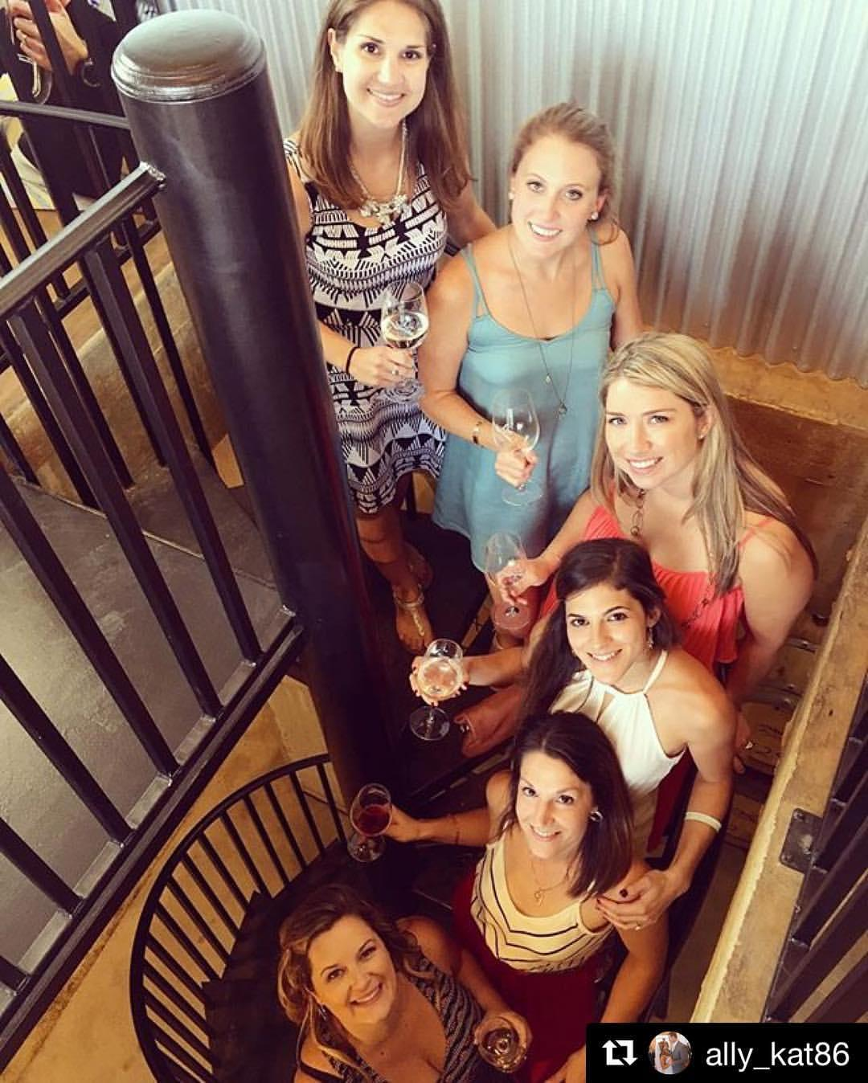
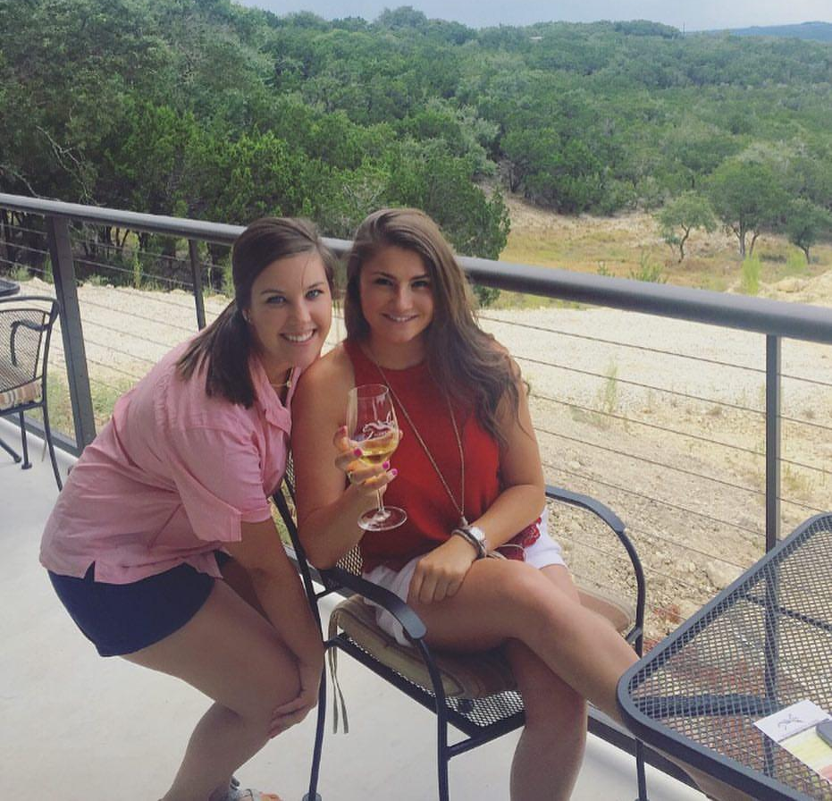
The Tasting Room
Conducting tastings
  After learning about the wines, grapes, and the different vintages I was flying solo
Working POS systems and opening/closing procedures
  Inventory and sales
Hospitality
  The importance for only being open once a week
  Working multiple events

Slide 9



I got to collaborate with a team and work with other Texas wineries for marketing and promotion. I got to complete events from the drawing board all the way to execution.

Slide 10
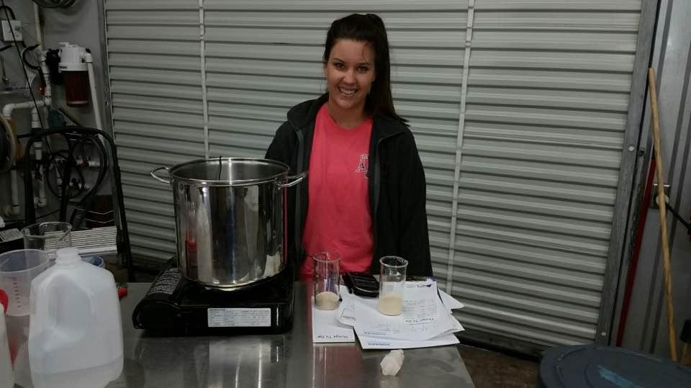
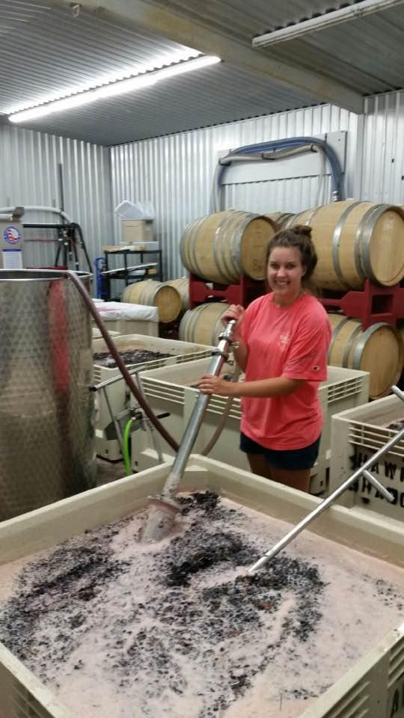
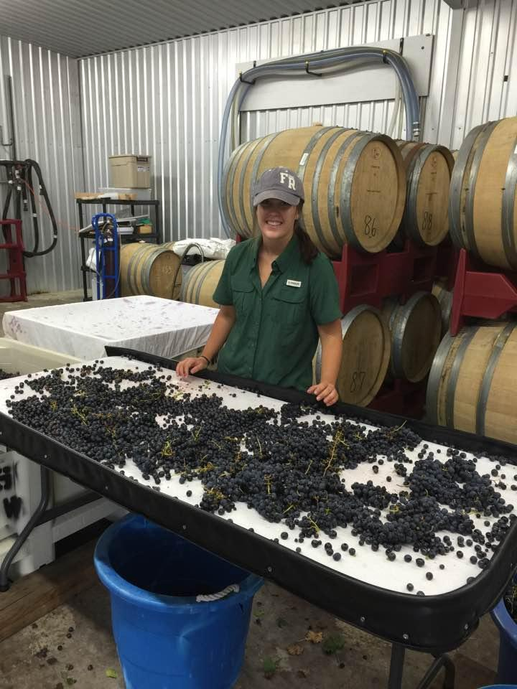

Slide 11
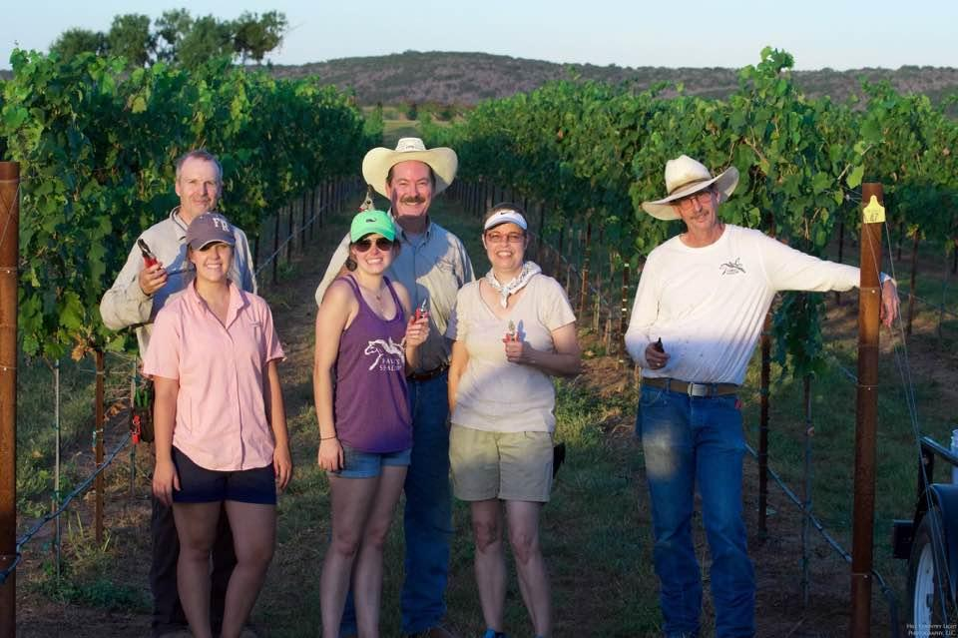
Thanks and Gig’em!
http://kourtneygcollins2016internshiphsv.blogspot.com/

